Slide 1
An Introduction to E-Cigarettes: What’s Old is New Again Tiffany Schuette – New Holstein Elementary School Counselor Casey Mertens – New Holstein Middle School Counselor Anna Carpenter – Health Educator, Winnebago County Health Department
Notes:
Add your logo and/or background here!

Slide 2
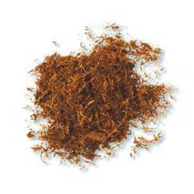
The Facts
Nicotine itself is toxic
Nicotine users suffer from nicotine addiction.
Notes:
Nicotine alone is toxic even before chemicals are added to tobacco products.
All e-cigarettes are derived from a regular tobacco plant. It’s like a form of liquid tobacco.
Nicotine is used as a pesticide because it takes away a bugs appetite like it takes away a smoker’s appetite.
So, no matter what form the nicotine is delivered (electronic or combustible) it still has toxic nicotine.
Nicotine users suffer from nicotine addiction and also suffer at the hands of those who profit from their addiction.
Photos: http://en.wikipedia.org/wiki/Tobacco & http://www.bridge-bradford.org.uk/about-drugs/nicotine

Slide 3
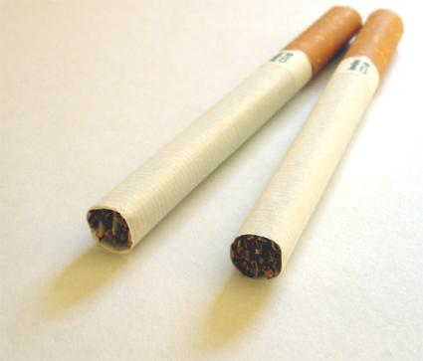
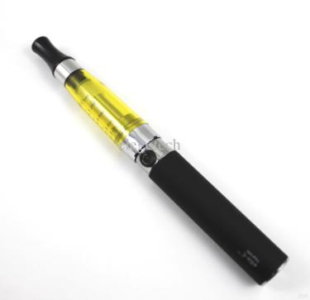
The Facts
Combustible Cigarettes
Electronic Cigarettes
1 cigarette = 1mg =
20 mg in a pack
1 e-cigarette cartridge =
approx. 20 mg
Notes:
The exact dose of nicotine the e-cigarette user will receive depends entirely on how fast and how hard they drag from the device.
The as advertised “safer and healthier” product is simply the most extreme way of pumping nicotine into the brain on demand. There is no research that proves it is safer.
Years ago filtered cigarettes were supposed to be a “safer way” of smoking.
Filtered cigarette users inhaled more deeply and frequently with each filtered cigarette they smoked.
The same is to be expected with e-cigarette users – They may find them as fuel but never satisfy their nicotine addiction.
Photos: http://en.wikipedia.org/wiki/Cigarette & http://www.dhresource.com/albu_258901664_00-1.0x0/high-quality-clearomizer-ce5-cartomizer-in.jpg

Slide 4
Retellings of a “safer cigarette”
Menthol
Filtered
Low tar/nicotine
Recessed filters
Spit/ Smokeless
Snus
Dissolvable tobacco
And now… Electronic Cigarettes
Notes:
For decades there have been many retellings of a “safer cigarette” from tobacco corporations such as:
Menthol, Filtered, Low tar/nicotine, Recessed filters, Spit Tobacco, Smokeless tobacco, Dissolvable tobacco, Snus, And now… Electronic Cigarettes

Slide 5
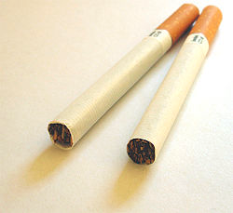
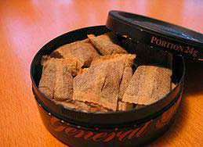
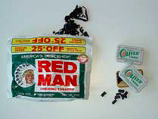
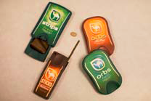
What’s Old Is New Again
Notes:
So, what’s old is new again. As laws are created tobacco corporations continue to develop a new and “safer” way of smoking.
As a result studies take years to prove that a certain tobacco product is not safe. In the mean time corporations have years to advertise these methods.
We need to ask ourselves… If these tobacco manufacturers WANT to make a safe tobacco product then why are they still selling the deadly ones? Since that has never happened the only safe alternative is not using any tobacco products at all.

Slide 6
Tobacco Corporations
Corporation
E-cigarette Brand
Lorillard
Reynolds Tobacco
Imperial Tobacco
Altria (Formerly Phillip Morris)
Blu Ecig
Vuse and Zonnic
Fontem Ventures Vapuour Products
MarkTen, NuMark & GreenSmoke Brands
Notes:
The major producers of traditional cigarettes now produce electronic cigarette brands (Will be mentioned later)

Slide 7
Notes:
Wisconsin passed a statewide smoke-free air law and has had success increasing the cigarette tax.
BUT…the fight is NOT over. The Tobacco Industry isn’t just going to concede a loss and leave Wisconsin. They are still here, trying to make a profit - in a BIG way.
Photos:
http://www.wibettersmokefree.com
http://www.trinketsandtrash.org/

Slide 8
e-cig·a·rette [ee-sig-uh-ret]
Notes:
E-cigarette is a general term used to reference an array of products that simulate smoking.

Slide 9
E-Cigarettes Include:
Notes:
The Public Health Law Center defines e-cigarettes as “any oral device that provides a vapor of liquid nicotine, lobelia, and/or other substance, and the use or inhalation of which simulates smoking. The term shall include any such devices, whether they are manufactured, distributed, marketed or sold as e-cigarettes, e-cigars, e-pipes, or under any other product name or descriptor.”

Slide 10
Notes:
The Public Health Law Center defines e-cigarettes as “any oral device that provides a vapor of liquid nicotine, lobelia, and/or other substance, and the use or inhalation of which simulates smoking. The term shall include any such devices, whether they are manufactured, distributed, marketed or sold as e-cigarettes, e-cigars, e-pipes, or under any other product name or descriptor.”
Photo: California State Health Report on E-cigarettes

Slide 11
Example of an E-Cigarette
Notes:
E-cigarettes are devices that allow users to inhale a vapor containing nicotine or other substances.
They are generally battery-operated and use a vaporizer to heat a refillable cartridge that then releases a chemical-filled vapor.
They come in many flavors such as gummy bear, strawberry, cherry crush and cotton candy.
Each e-cigarette is different. Some can be customized with the concentration of nicotine in the flavored “juice,” the amount of the draw and the temperature of the hit.
The health consequences of the inhalants and the vapors they give off are unknown.
There is currently no scientific evidence establishing the safety of e-cigarettes.
Photo: http://changelabsolutions.org/publications/e-cig-regulation
[Title of the course]
18-Feb-15
Copyright © 2004-2005 NameOfTheOrganization. All rights reserved.
11

Slide 12
Top 6 Reasons to be concerned about e-cigarettes
Notes:
There are a number of reasons to be concerned about these products. Let’s talk about them.

Slide 13
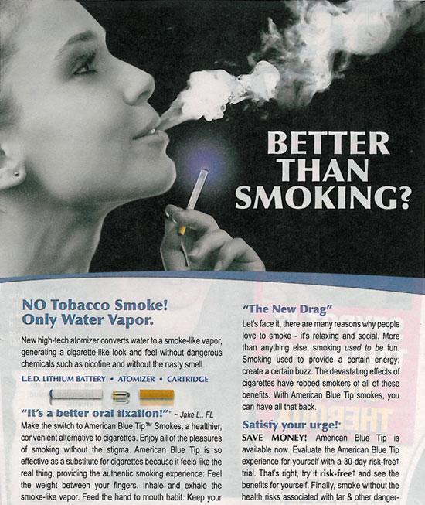
#1) E-cigarettes give off more than just “water vapor.”
Notes:
#1) E-cigarettes give off more than just “water vapor.”
E-cigarettes produce a vapor (also referred to as aerosol) upon each inhalation that resembles and tastes like the smoke produced by cigars and cigarettes.
While the health effects of the vapor are unknown, initial lab tests conducted by the FDA found detectable levels of toxic cancer-causing chemicals, including an ingredient used in anti-freeze.
Instead of comparing the aerosol from e-cigarettes to secondhand smoke, we should be comparing it to clean air.
We’ve worked hard for the right to breathe clean air and e-cigarette vapor doesn’t meet this standard.
A 2011 German study found that secondhand emissions from e-cigs created ultra fine particles that can deeply penetrate the lungs of bystanders. Basically there are dust related particles that enter the lungs and don’t leave. In this study the unknown health consequences of repeatedly inhaling the toxins worried the researchers.
Photo: http://www.trinketsandtrash.org/ & California State Health Report on E-cigarettes

Slide 14
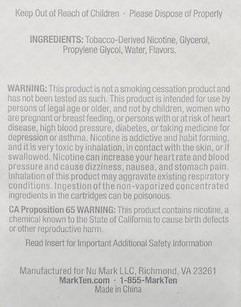
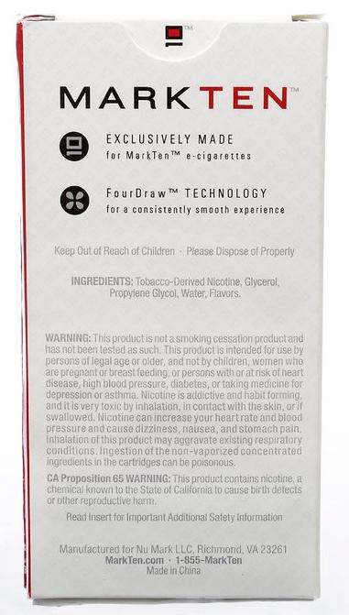
Notes:
#1) E-cigarettes give off more than just “water vapor.”
E-cigarettes produce a vapor (also referred to as aerosol) upon each inhalation that resembles and tastes like the smoke produced by cigars and cigarettes.
While the health effects of the vapor are unknown, initial lab tests conducted by the FDA found detectable levels of toxic cancer-causing chemicals, including an ingredient used in anti-freeze.
Instead of comparing the aerosol from e-cigarettes to secondhand smoke, we should be comparing it to clean air.
We’ve worked hard for the right to breathe clean air and e-cigarette vapor doesn’t meet this standard.
A 2011 German study found that secondhand emissions from e-cigs created ultra fine particles that can deeply penetrate the lungs of bystanders. Basically there are dust related particles that enter the lungs and don’t leave. In this study the unknown health consequences of repeatedly inhaling the toxins worried the researchers.
Photo: http://ecigarettereviewed.com

Slide 15
#2) E-cigarettes undermine clean indoor air policies by making enforcement confusing.
Notes:
#2) E-cigarettes can undermine clean indoor air policies by making enforcement confusing.
Vaping creates a dense mix of vapor and fine particles that looks like tobacco smoke. If exempt from clean indoor air policies, the ‘smoky look’ creates confusion with enforcement.
Some people are using e-cigarettes to disguise illicit drug use, which makes enforcement difficult. Because the devices don’t produce a flame, a person smoking marijuana in an e-cigarette can take a puff and then quickly put it in a pocket.
Photo: http://www.trinketsandtrash.org/

Slide 16
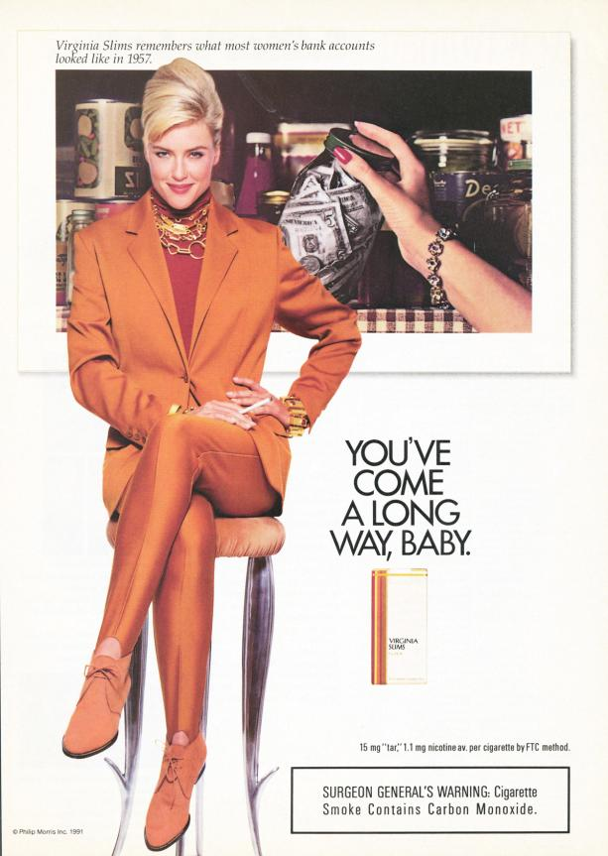
#3) no regulation on manufacture and sale of e-cigarettes to protect consumers.
Notes:
#3) There are no regulations on the manufacture and sale of e-cigarettes to protect consumers.
The safety of e-cigarettes is unknown.
Contents vary widely and may not match the ingredients or amounts listed on the label. E-cigarettes labeled as zero nicotine may still contain nicotine.
Nicotine in e-cigarette fluid (also known as ‘juice’) can be deadly if ingested improperly.
Nicotine cartridges contain 20 mg, the refill bottles may contain up to 7 Grams of nicotine.
Considering that a single 50 MILLIGRAM nicotine dose could potentially kill an adult, this means that 1 refill bottle has enough nicotine to kill 140 adults.
Why would the manufacturers sell a highly concentrated solution? The more concentrated the solution the lighter the nicotine product: the lighter the nicotine product, the lower the taxes. Tobacco taxes are based on the weight of tobacco they contain.
There has been an increase in reports of calls to the Food and Drug Administration (FDA) and poison control centers due to e-cigarettes.
Some e-cigarette devices have caused fires in cars and homes while charging.
Photos:
http://www.trinketsandtrash.org/
http://web.stanford.edu/group/ccr/blog/2007/11/nation_club_malboro_man_ad.html
http
http://171.67.24.121/tobacco_web/images/tobacco_ads/womens_cigarettes/virginia_slims/large/vslims_13a_3.jpg

Slide 17
#4) E-Cigarettes are not approved by the FDA to help smokers quit.
Notes:
#4) E-Cigarettes are not approved by the FDA to help smokers quit.
Despite manufacturer’s claims, not one of these products has been approved by the FDA as a cessation device.
We know what works. The combination of cessation counseling and FDA-approved medications, such as nicotine patches, lozenges and gum, is the most effective strategy to help smokers quit.
Photo: http://www.trinketsandtrash.org/

Slide 18
#5) E-cigarette users often continue to also smoke regular cigarettes.
Notes:
#5) E-cigarette users often continue to smoke regular cigarettes as well as use e-cigarettes.
E-cigarettes are marketed as a way to circumvent clean indoor air laws.
For example, users smoke e-cigarettes indoors and regular cigarettes outside.
Since these products are being marketed as an alternative for smokers when they cannot smoke, their use can potentially lead to the dual use of cigarettes and e-cigarettes.
The e-cigarette by nature works as an addiction device, not a cessation aid.
This means they don’t quit. They just use a new, potentially harmful product in addition to continuing to smoke.
Photo: http://www.trinketsandtrash.org/

Slide 19
#6) E-Cigarettes appeal to youth.
“Traditional” Marketing
Celebrity Endorsements
Social Media
Trendy
Rebellious
Sex Appeal
Glamorous
Fun
Notes:
#6) E-Cigarettes appeal to youth.
Glamorous marketing of these products includes tv and magazine ads, online promotions, social media, billboards and even shout outs at the Golden Globes.
These advertisements dress up e-cigarettes as a better smelling, cheaper and guilt free alternative to smoking.
The tobacco industry is using the same marketing tricks for e-cigarettes that they once used for traditional tobacco products. Since e-cigarettes are not regulated, marketing strategies which are illegal for tobacco products are fair game when it comes to e-cigarettes.
The volume of e-cigarette marketing is increasing daily. This amplified attention could lead to the re-normalization and social acceptability of smoking cigarettes.
Photos: http://www.advantagemarketingks.com/uploads/2/2/8/3/22833372/6523851.gif?450
http://www.hollywoodreporter.com/sites/default/files/2014/01/oscar_statue.jpg
http://queerty-prodweb.s3.amazonaws.com/wp/docs/2014/07/emmy07_11.gif
http://www.iriefm.net/sites/default/files/news/2014-12-03%2012%3A07/grammy-trophy.png

Slide 20
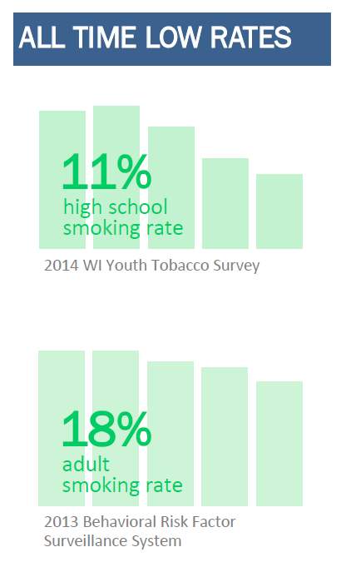
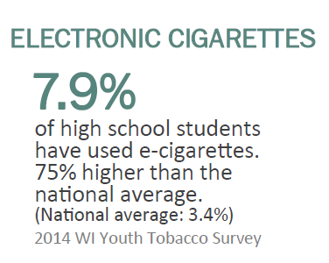
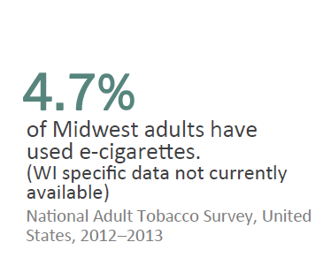
Trendy

Slide 21
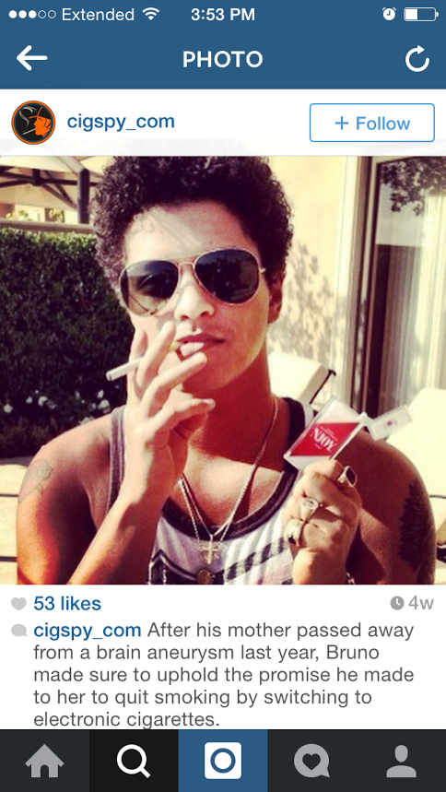
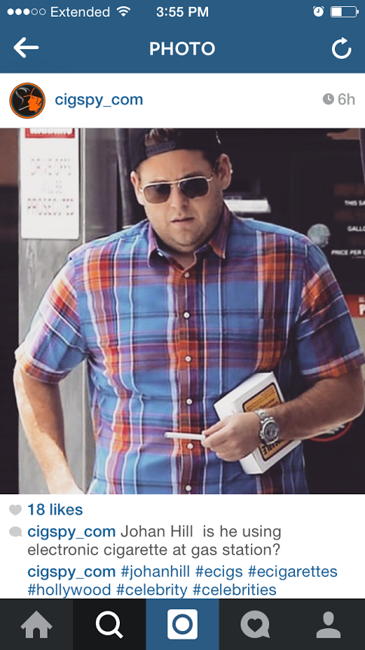
Trendy

Slide 22
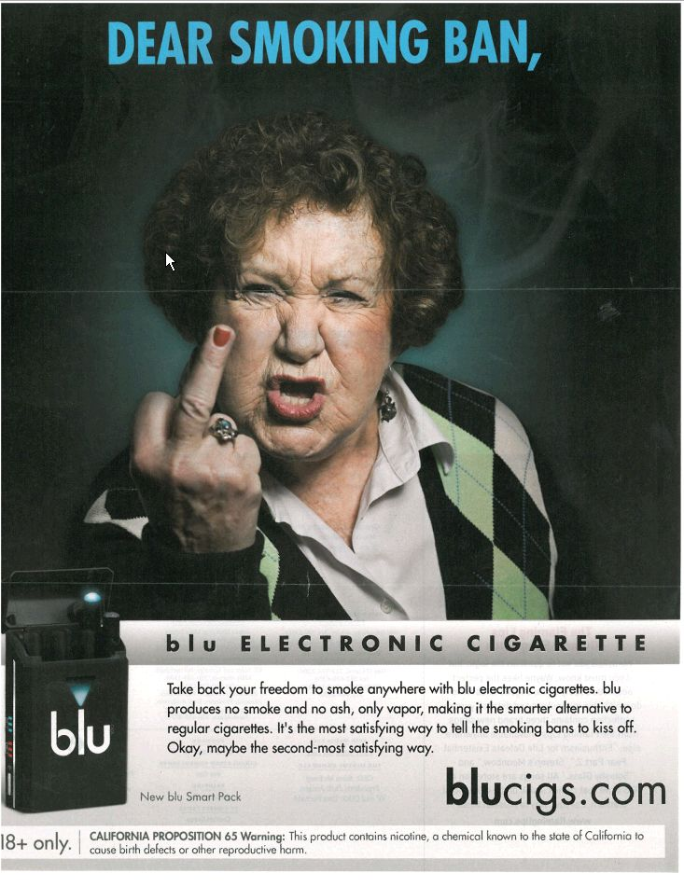
Rebellious
Notes:
http://www.trinketsandtrash.org
http://www.tobaccofreekids.org/ad_gallery/P150

Slide 23
Sex Appeal
Notes:
Photo: http://www.trinketsandtrash.org

Slide 24
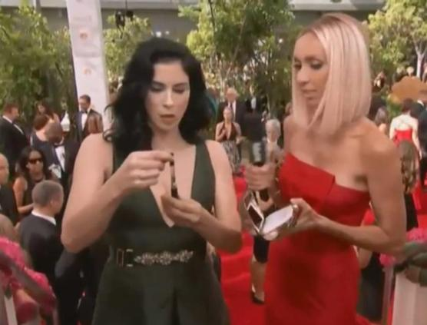
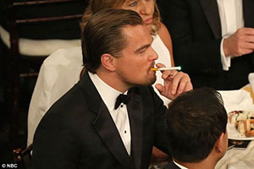
Glamorous
Notes:
Photos:
http://www.hollywoodreporter.com/sites/default/files/imagecache/675x380/2014/01/julia_louis_dreyfus_e_cig_a_l.jpg
http://assets.nydailynews.com/polopoly_fs/1.1918040!/img/httpImage/image.jpg_gen/derivatives/article_970/pot27f-1-web.jpg
http://media.nbcchicago.com/images/654*369/jenny-mccarthy-e-cig.jpg
http://ecigarettenews.net/wp-content/uploads/2014/02/Leo-at-Golden-Globes-300.jpg
http://images.huffingtonpost.com/2014-02-01-alg_electroniccigarette_katherineheigl300x225.jpg

Slide 25
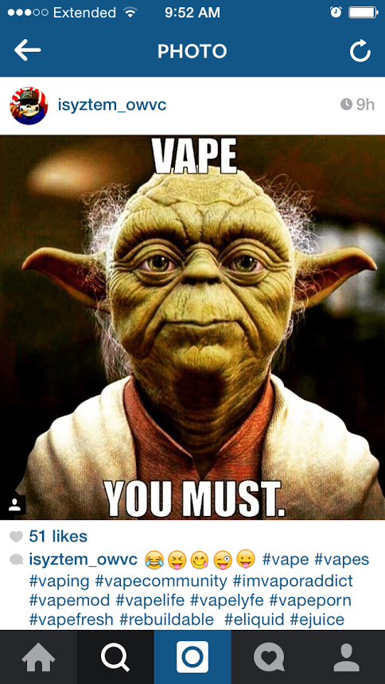
Fun

Slide 26
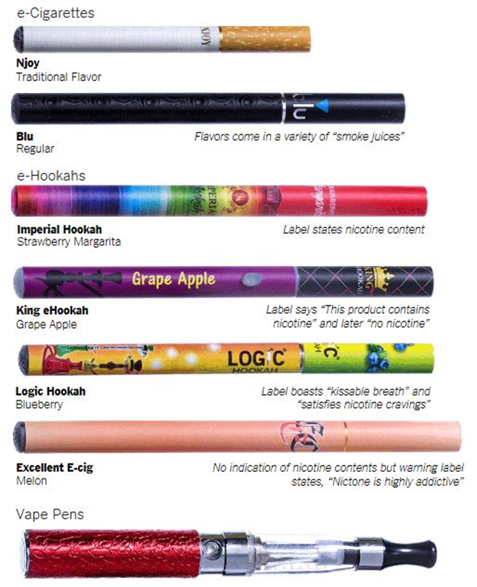
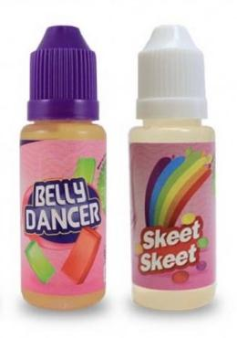
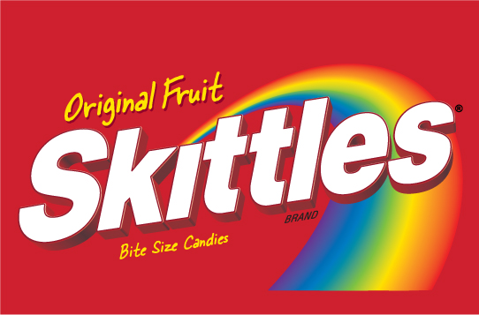
Fun: Flavors
Notes:
They come in many flavors such as gummy bear, strawberry, cherry crush and cotton candy.

Slide 27
Dr. Brian D. Harrison
Dr. Harrison is the medical director of Health and Productivity Management for Affinity Health System.
Occ Doc in a Box Blog: http://affinityocchealth.blogspot.com/
Quote about the bottom line:
Tobacco is Harmful
Notes:
“If we once again monitor the population before convincing ourselves of what we already know, namely tobacco kills, only now in terms of the latest shiny new toy from the tobacco industry, well, shame on us. We already know the toxicity of the chemical ingredients. Blending these together and then vaporizing them, repeatedly inhaling them deeply for years, driven by addiction, probably will yield adverse health effects that we simply won’t recognize until then. This route of exposure remains completely unstudied. We stand to lose a half-century of hard earned gains in healthier living by inaction.”
***Never ending battle.

Slide 28
Key Points
E-cigarettes aren’t good for our air or our kids
E-cigarettes are not safe
E-cigarettes are unregulated
marketing, sale and distribution
Quit help claims are unproven
Notes:
Key Points
E-cigarettes aren’t good for our air or our kids
E-cigarettes haven’t been proven to be safe
Unregulated marketing, sale and distribution
Smoking Cessation claims are unproven

Slide 29
What Can You Do?
Update District-wide policies from “Smoke Free Facilities” to “Tobacco Free Facilities”
Elementary Level
Middle School Level
High School Level
Notes:
Elementary – Share lesson plan on the dangers of smoking – Kids would ask about e-cigarettes and they already think it is “safer” than a regular cigarette. Educate kids about how addictive nicotine is and use the motto “If you never start you never have to stop”.
Middle -
High -
Update District-wide policies from “Smoke Free Facilities” to “Tobacco Free Facilities” – New Holstein School district did update their policy to Tobacco free which includes all forms of tobacco products including e-cigarettes.

Slide 30
What Can You Do?
Join your tobacco prevention coalition
Write letters to the editor
Educate community organizations
Educate policy makers
Notes:
Join our coalition
Link the audience to your coalition or tobwis.org
Write letters to the editor – here’s why:
We can get our message out there
Newspapers are fairly good about running them, especially in smaller communities
People read them – the opinion page is second only to the front page in readership
A few tips: Stay positive, keep it short (250 words), avoid numbers, use comparisons, tell a story, keep it local, short paragraphs, write simply (write as you speak).
Educate community organizations using this powerpoint presentation
Educate policy makers
It’s important to educate policy makers to the problem of e-cigarettes and explain possible solutions.
Community members are instrumental in educating policy makers on issues that affect youth in their communities.
LOCALIZE THIS SLIDE…..
Put a picture from your community here – whether it’s a picture of a local legislator being educated on e-cigarettes/tobacco prevention and control. Then talk about where you’ve seen e-cigarettes marketed in your community.
Share a story about a time you met with a legislator or local elected official at a legislative meeting coming up that people could attend or encourage them to write a letter to their legislators regarding their concerns about e-cigarettes.

Slide 31
For Resources and Support
Tobwis.org
Occ Doc in a Box Blog: http://affinityocchealth.blogspot.com
Notes:
Add your contact information here!

Slide 32
Questions?
Tiffany Schuette
Elementary School Counselor
New Holstein School District
(920) 898-4208
tschuette@nhsd.k12.wi.us
Casey Mertens
Middle School Counselor
New Holstein School District
(920) 898-4769
cmertens@nhsd.k12.wi.us
Anna Carpenter
Health Educator, Coalition Coordinator
Winnebago County Health Department
(920) 232-3009
acarpenter@co.winnebago.wi.us
?

Slide 33
References
Tobwis.org http://www.tobwis.org/resources#!/tags=e-cigarettes
Occ Doc in a Box Blog: http://affinityocchealth.blogspot.com/

